Slide 1
Al-Farabi Kazakh National University
Higher School of Medicine
Regulation of gene expression in procaryotes and eucaryotes
Lecturer: PhD Pinsky Ilya Vladimirovich

Slide 2
LEARNING OUTCOMES
As a result of the lesson you will be able to:
1. Define the terms: operon, cistron, promoter.
2. Explain the functioning and regulation of the following operons: lac, ara, trp, gal.
3. Explain positive and negative controls of operons.
4. Differentiate between constitutive and inducible promoters.
5. Explain the mechanism of transcription regulation in eukaryotes.
6. Describe the structure of the promoter: TATA-box, GC-box.
7. Explain the functions of enhancers and silencers.
8. Describe the role of transcription factors and activators in the regulation of transcription
9. Describe the structure and significance of DNA-binding domains and transcription activation domains.
10. Compare translation regulation in pro- and eukaryotes.

Slide 3
Literature
Alberts et al., pp. 369-392;
Alberts et al., pp. 413-429.

Slide 4
WHAT FOR REGULATE GENE EXPRESSION??
Adaptation (Energy Conservation)
Development
Differentiation

Slide 5
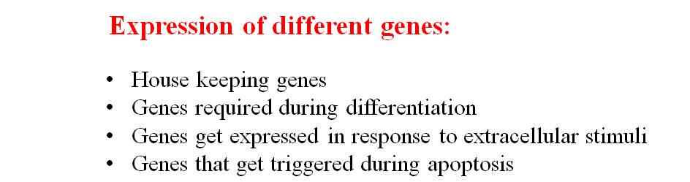

Slide 6
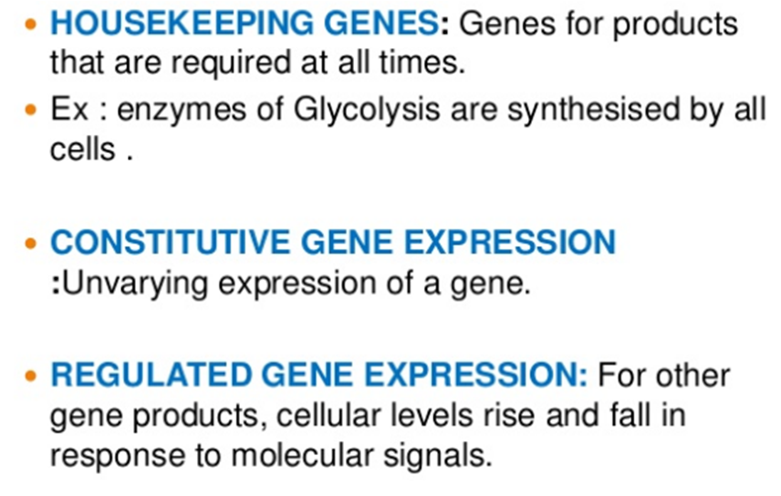

Slide 7
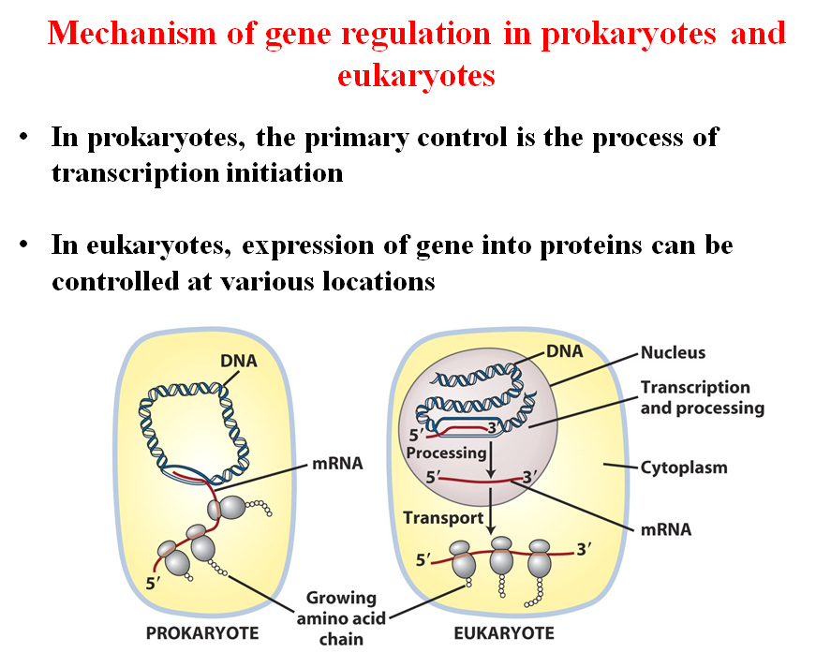

Slide 8
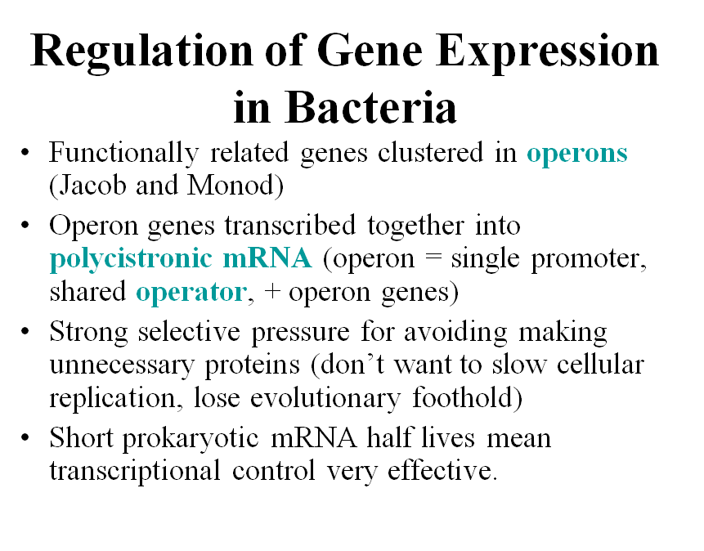

Slide 9
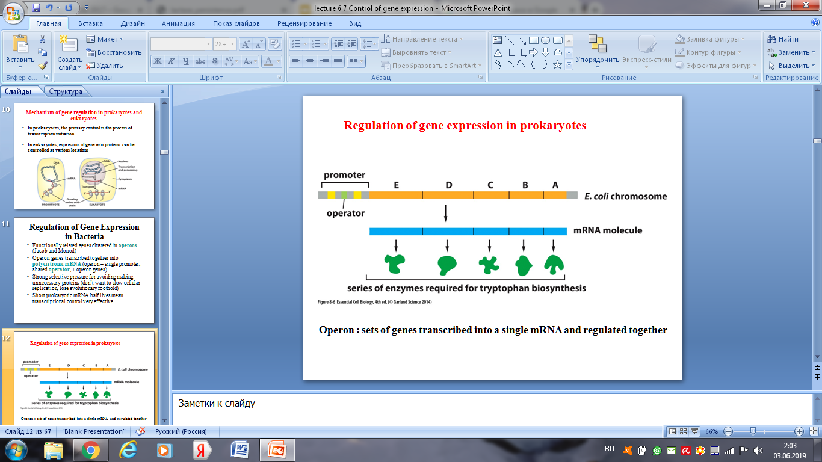

Slide 10
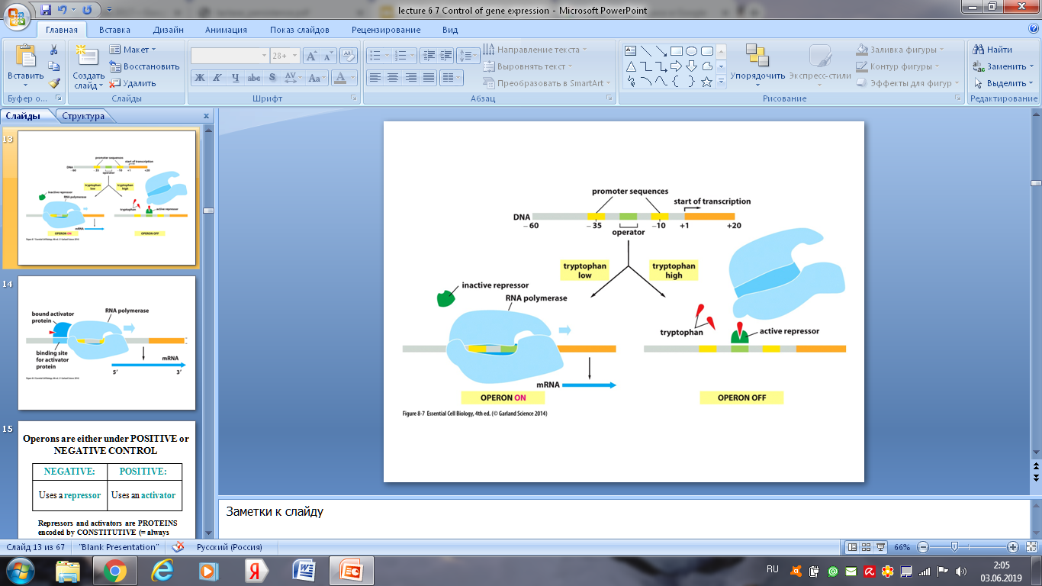

Slide 11
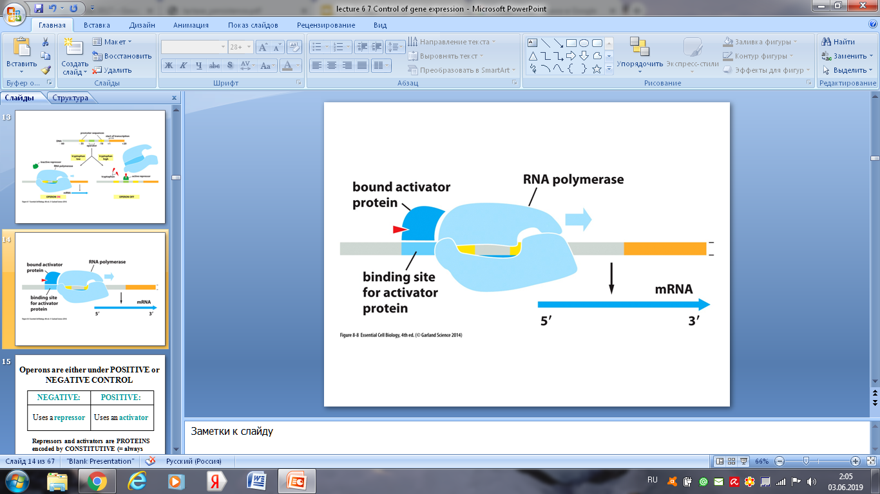

Slide 12
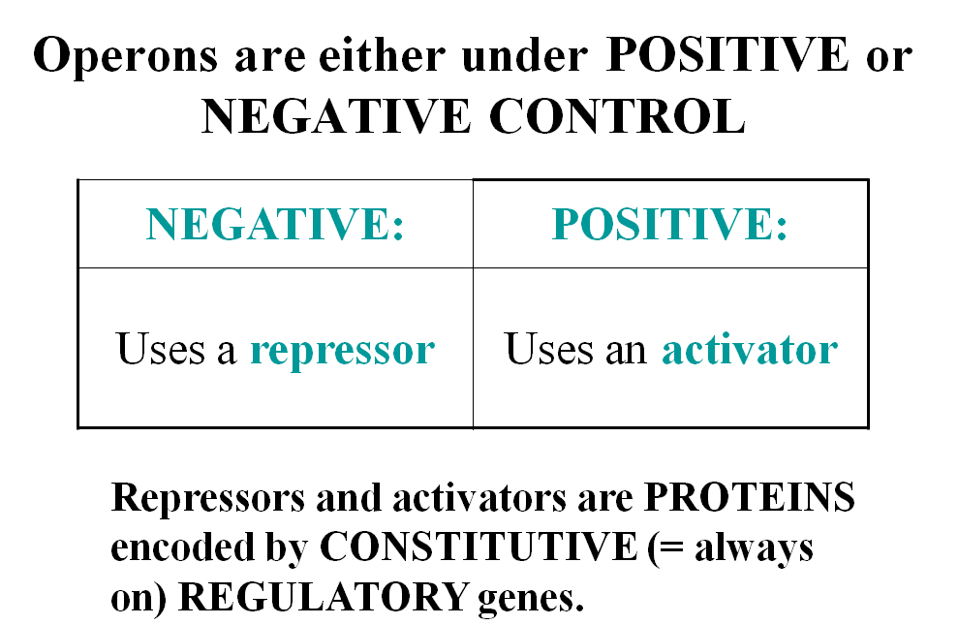

Slide 13
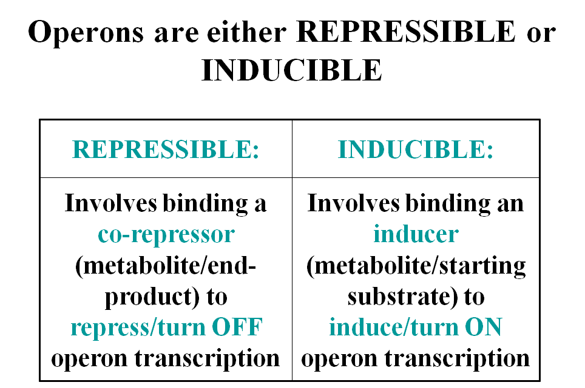

Slide 14
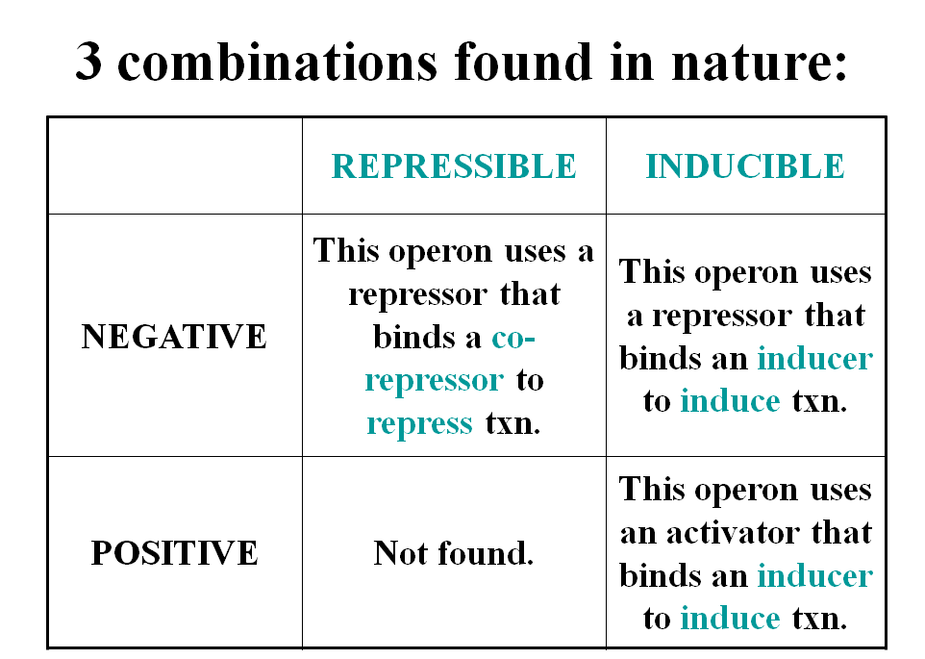

Slide 15
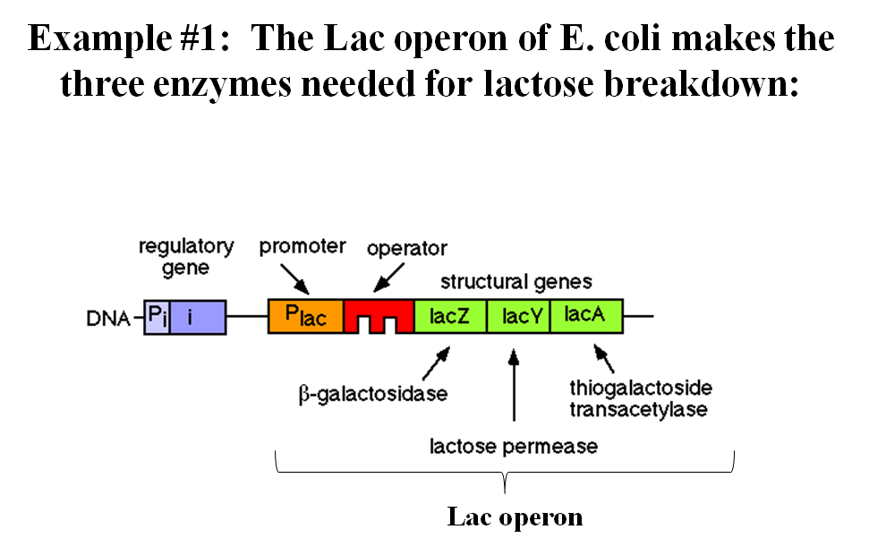

Slide 16
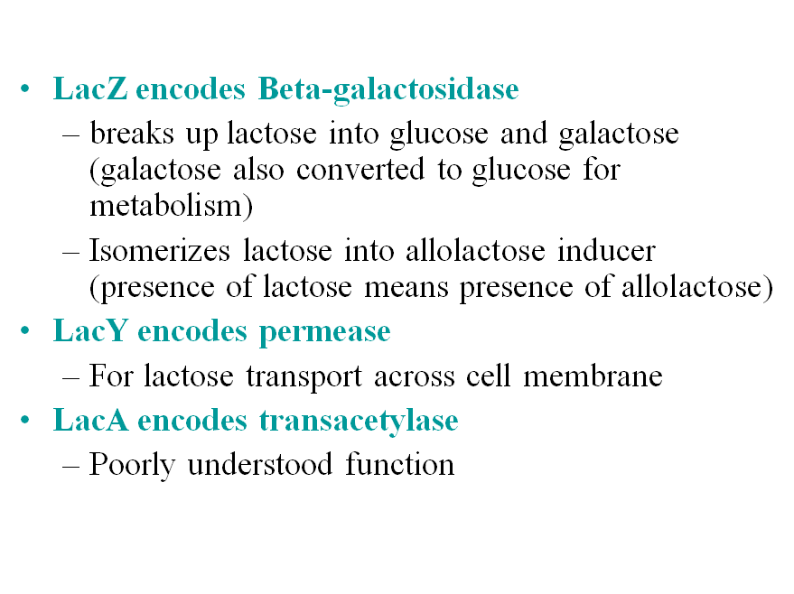

Slide 17
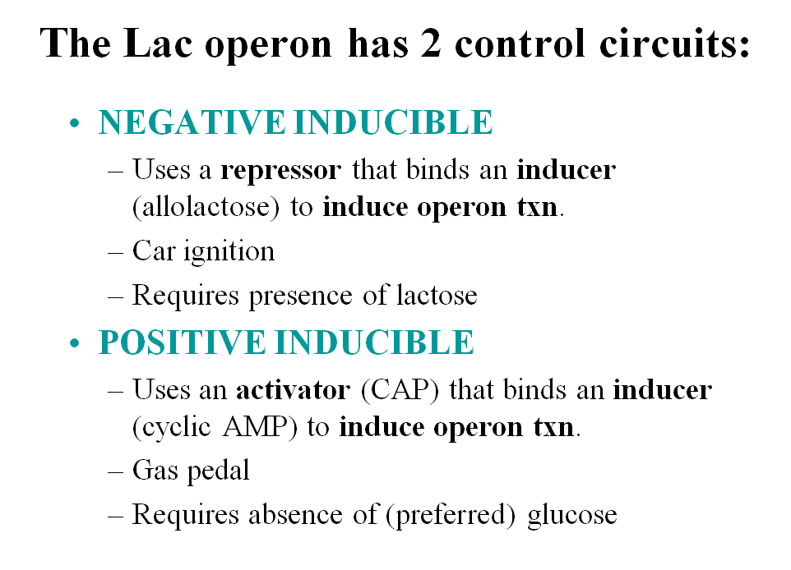

Slide 18
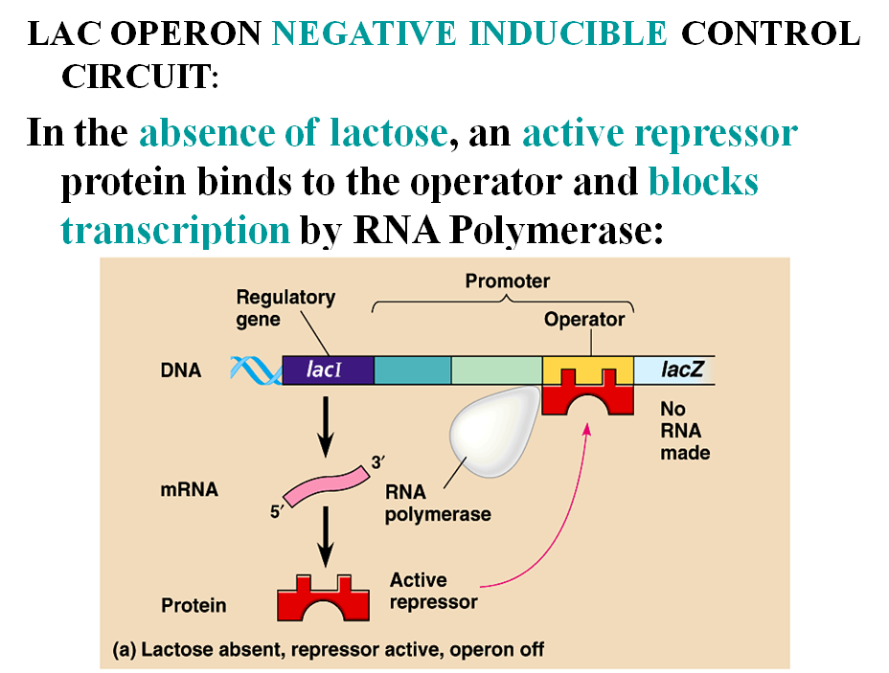

Slide 19
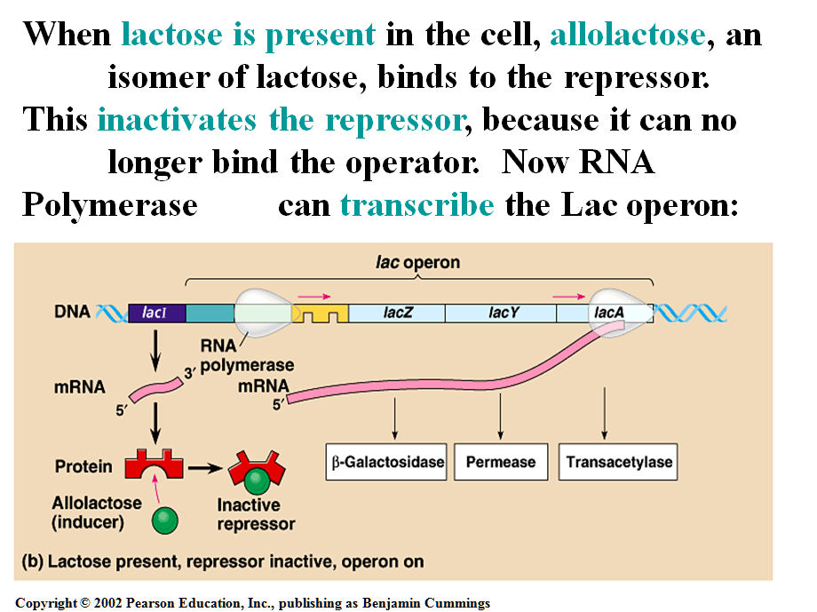

Slide 20
Questions
1. How do you think, why genome organization is different in prokaryotes and eucaryotes? Why procaryotic genes are organized in operons?
2. The genes of antibiotic resistance in prokaryotes are constitutive or inducible? Make the basis for your answer.

Slide 21
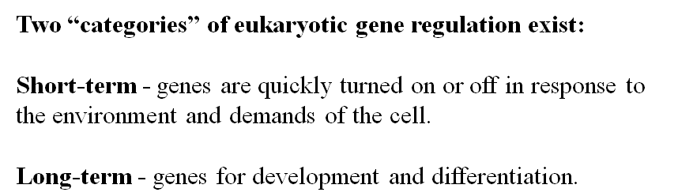
Regulation of gene expression in eukaryotes

Slide 22
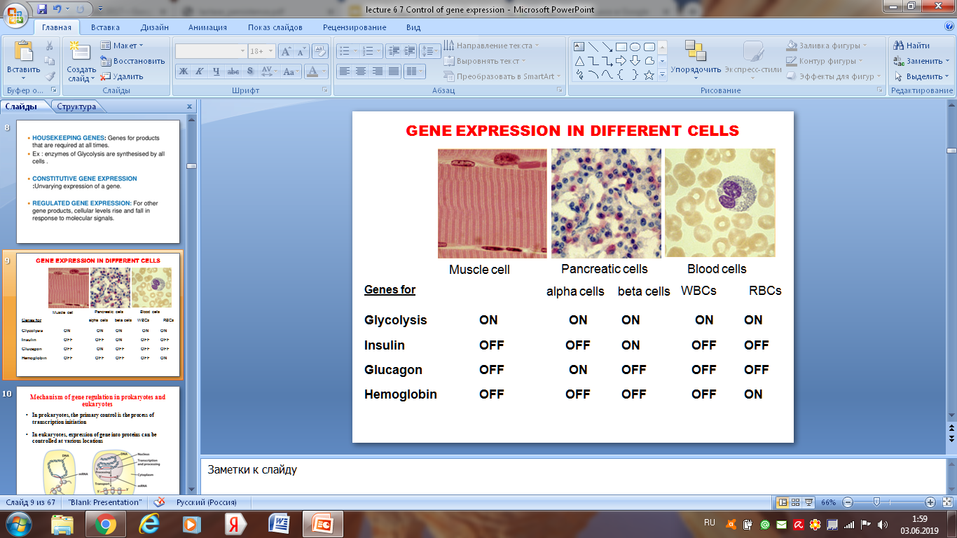

Slide 23
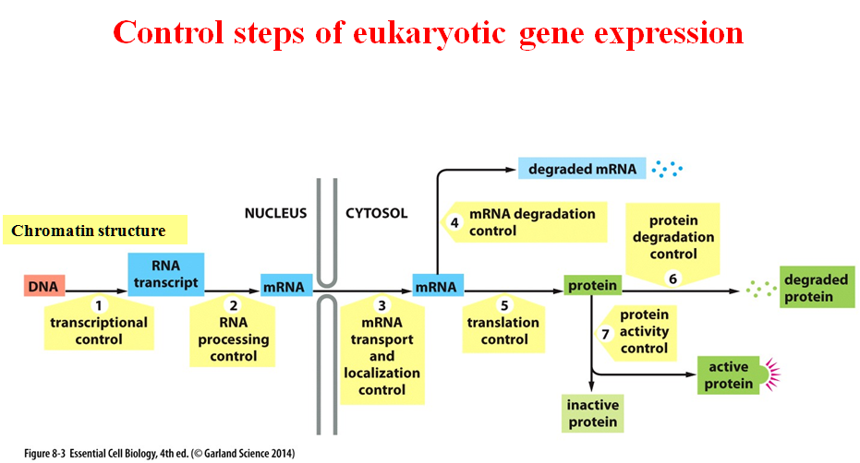

Slide 24
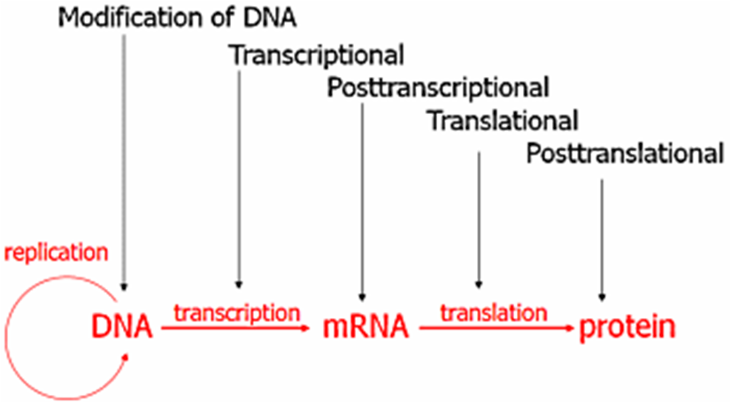

Slide 25
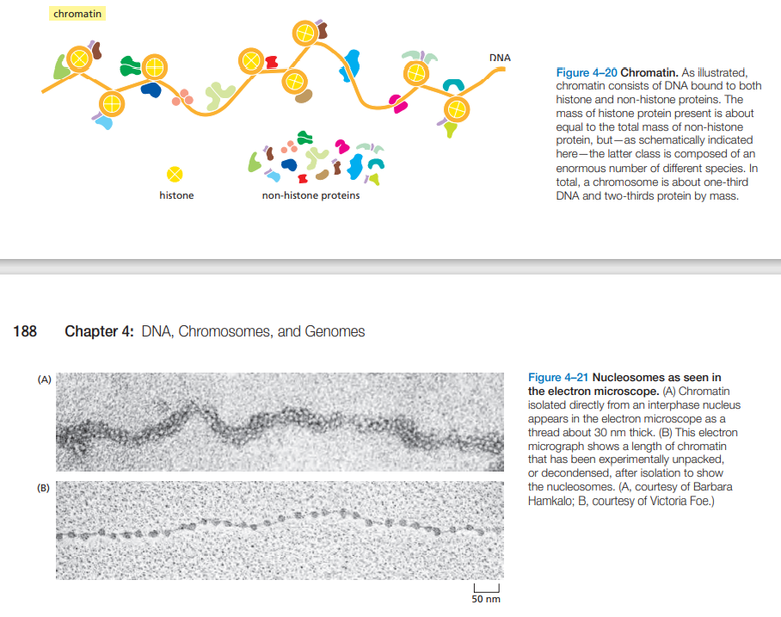

Slide 26
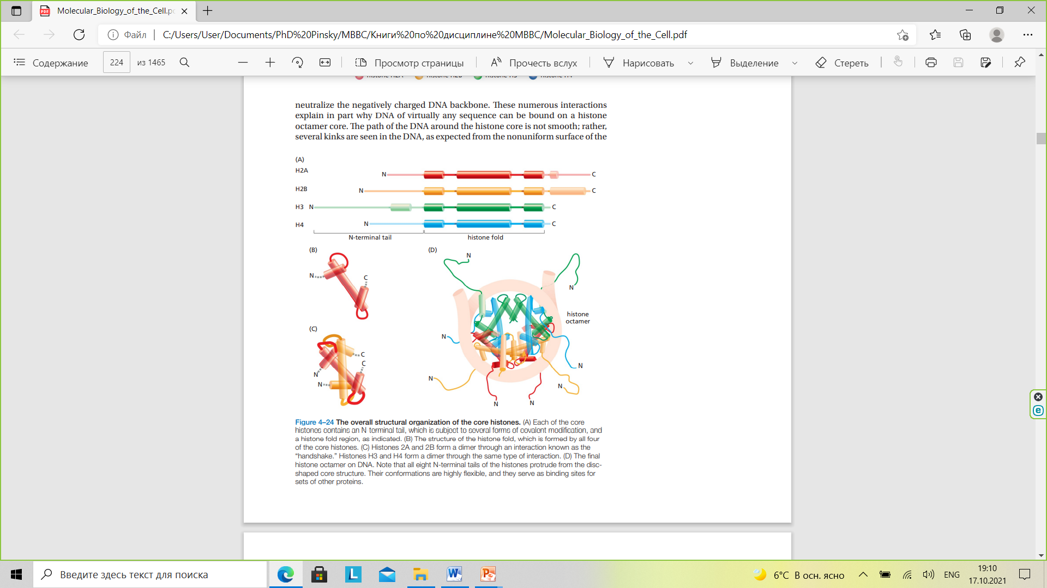

Slide 27
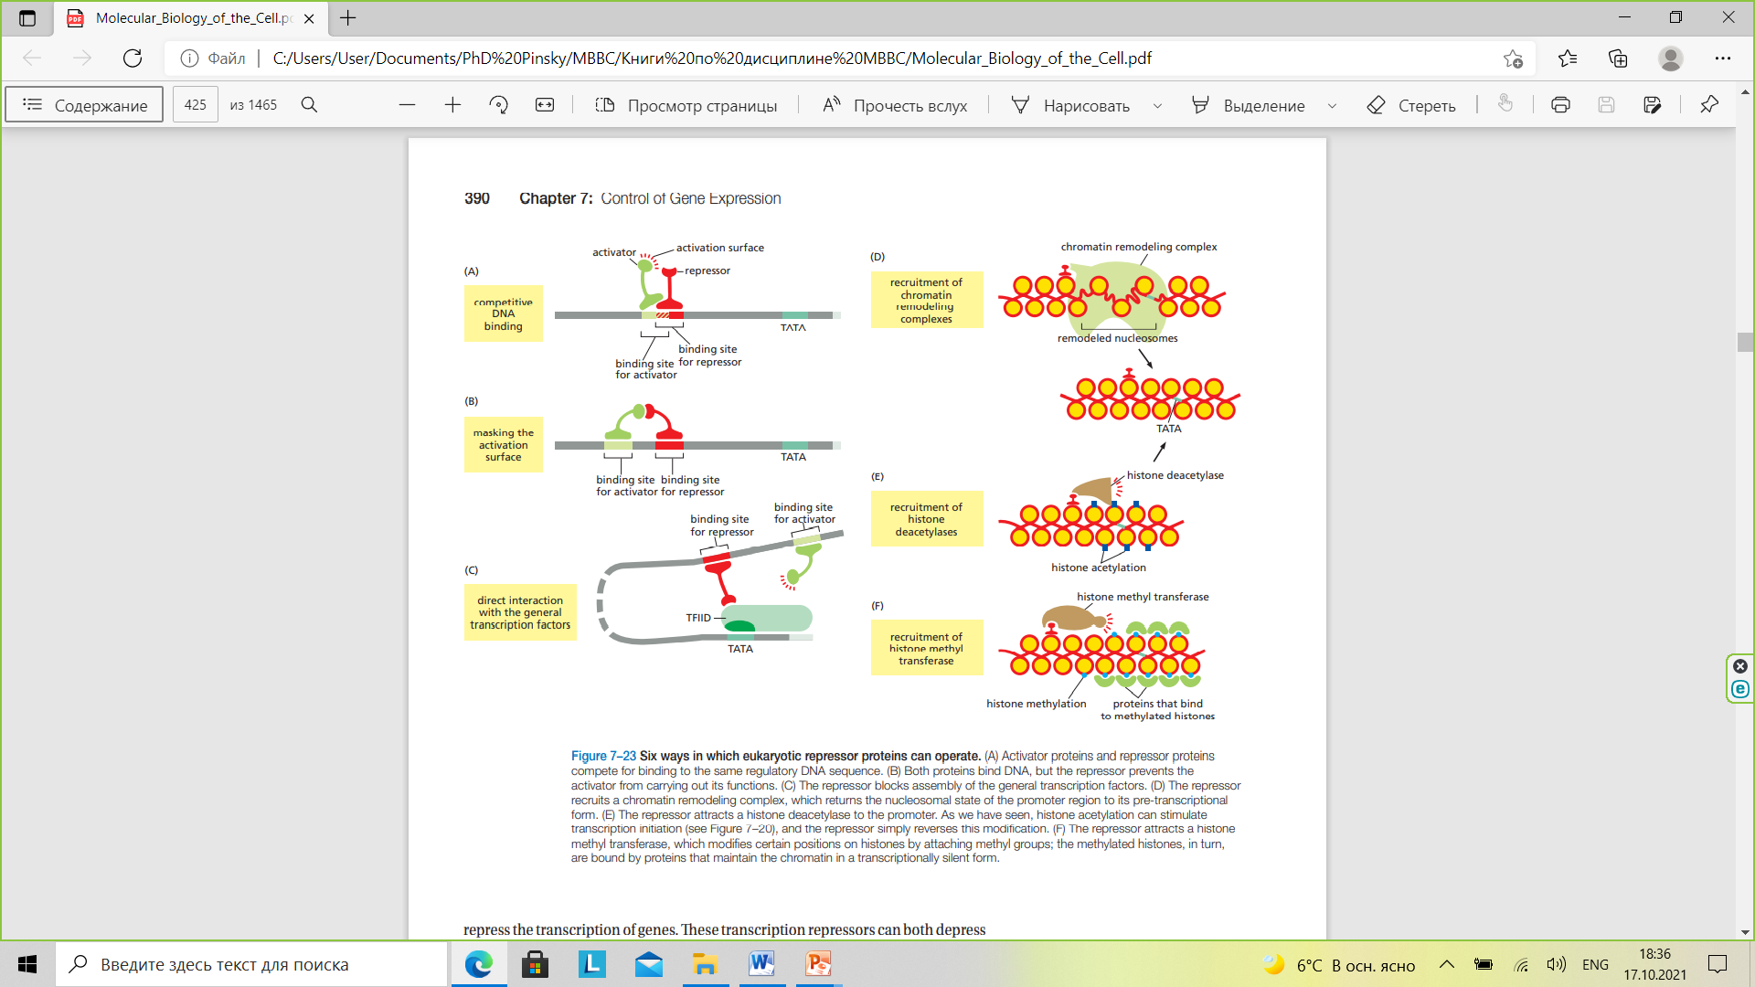

Slide 28
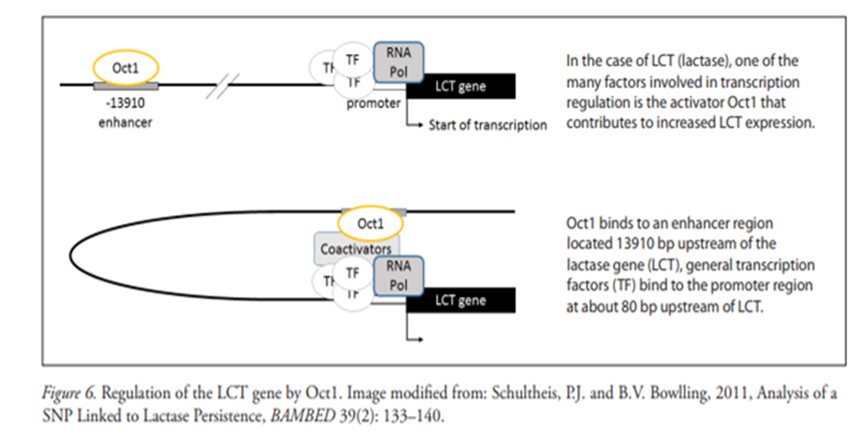

Slide 29
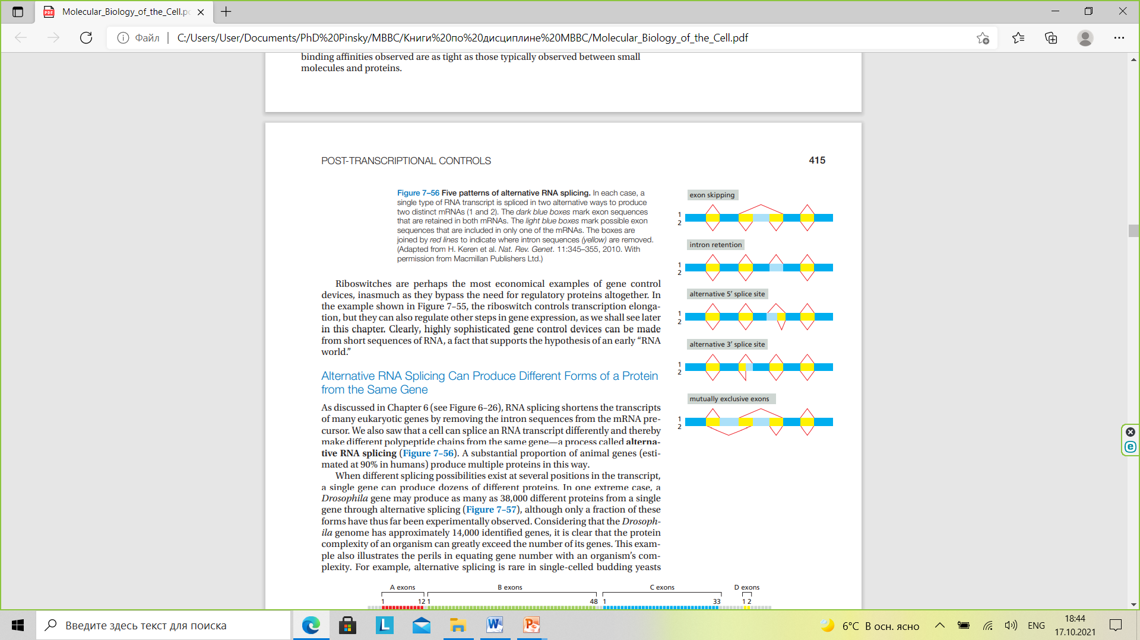

Slide 30
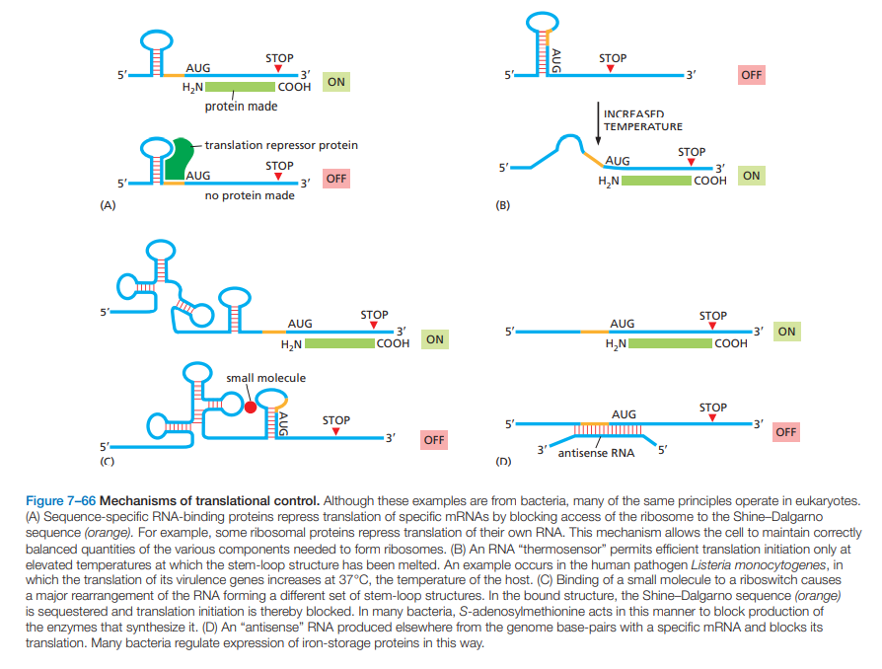

Slide 31
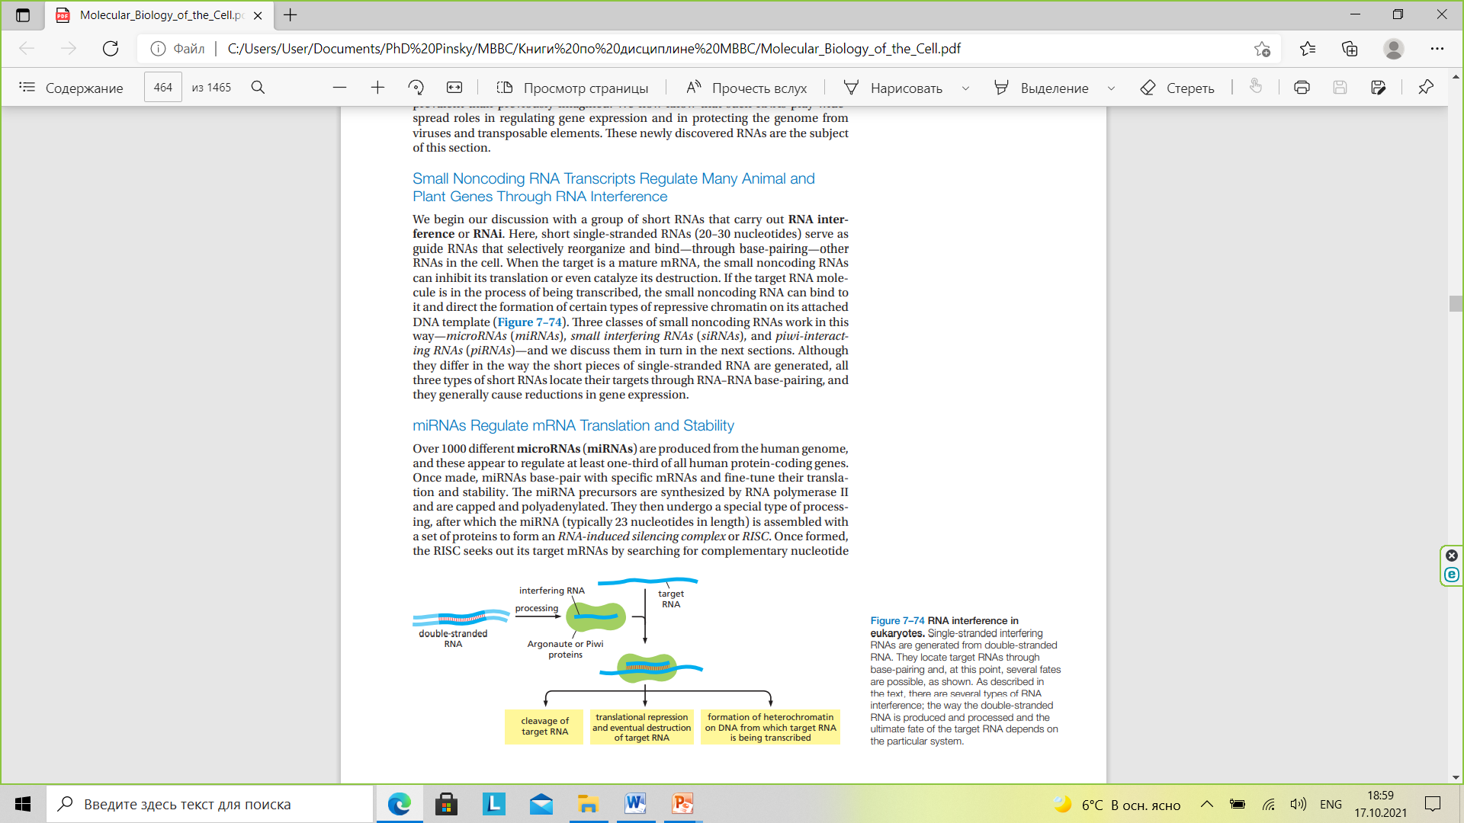

Slide 32
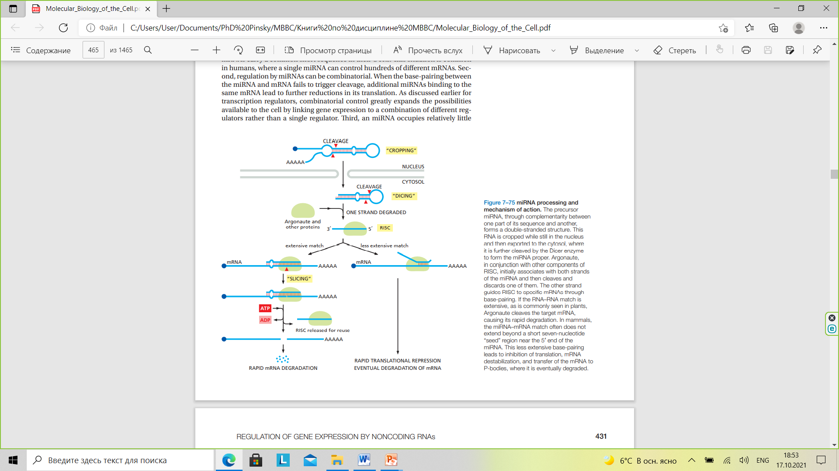

Slide 33
